Slide 1
CGB1221-DATABASE MANAGEMENT SYSTEM
Department of Artificial Intelligence and Data Science
Academic Year: 2024 – 2025
Register Number : 2303811724322086
Name : Raghavi S A
Year : II
Semester : IV
Section : B
Date : 04.06.2025

Slide 2
Title of the Project
TASK MANAGEMENT SYSTEM

Slide 3
Problem Identification
1. Lack of Task Organization
Tasks are often scattered across emails, chats, or paper notes.
2. Difficulty in Assigning and Tracking Tasks
Managers struggle to monitor task progress.
3. Missed Deadlines
Employees forget deadlines due to lack of reminders.
4. Poor Collaboration and Communication
Team members lack visibility on who is responsible for what.

Slide 4
Objective
Task Creation & Management – Allow users to add, edit, delete, and prioritize tasks.
Task Assignment – Enable assigning tasks to specific users or teams.
Deadline & Reminder System – Notify users of upcoming and overdue tasks.
Progress Tracking – Monitor task status (Pending, In Progress, Completed).
User Roles & Access Control – Define permissions for admins, managers, and employees.
Collaboration & Communication – Allow comments, file attachments, and updates on tasks.

Slide 5
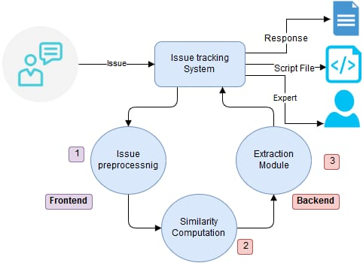
Proposed Architecture

Slide 6
List of Modules
User Management Module
Task Management Module
Task Tracking & Progress Module
Notification & Reminder Module
5. Reports & Analytics Module

Slide 7
Module Description
1. User Management Module
User Registration: Secure sign-up process collecting user details like name, email, password (hashed), and role (admin/user).
Login & Authentication: Login with encrypted password verification and session/token-based authentication.
Role-Based Access Control (RBAC): Assign permissions (e.g., only admins can delete tasks or manage users).
Profile Management: Users can update personal details, change passwords, and upload profile pictures.
User Status & Activity Logs: Track login/logout times and user activity for auditing and analytics

Slide 8
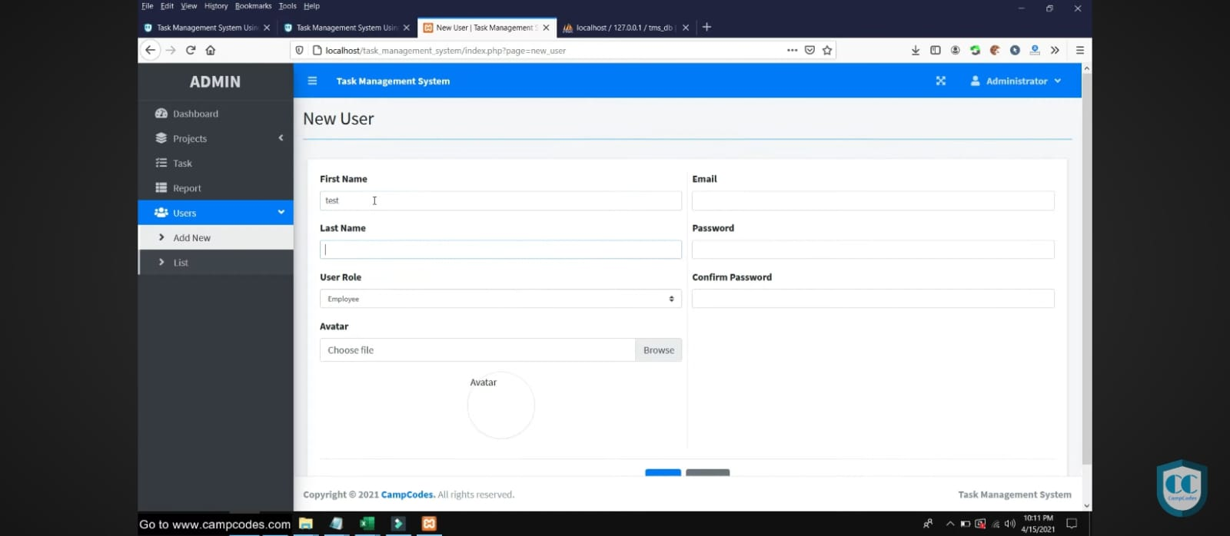
1. User Management Module

Slide 9
Module Description (Cont..)
2. Task Management Module
Task Creation: Add new tasks with title, description, deadline, priority, category, and assignee.
Edit/Delete Tasks: Allow authorized users to modify or delete tasks with audit tracking.
Task Assignment: Assign tasks to users or teams, notify assignees automatically.
Priority & Categorization: Set task priority levels (High/Medium/Low) and categorize for better organization.
Deadline Management: Validate and enforce deadlines with alerts for past-due entries.

Slide 10
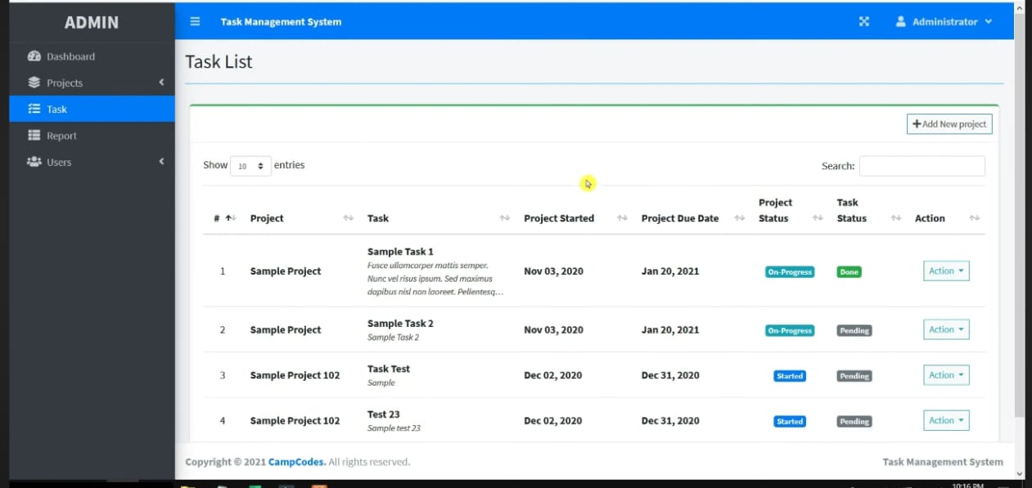
2. Task Management Module

Slide 11
Module Description (Cont..)
3. Task Tracking & Progress Module
Status Updates: Change task status between Pending, In Progress, Completed, or custom stages.
Timeline View: Display task progress using Gantt charts or simple list views with timestamps.
Filter/Search Options: Filter tasks by status, priority, category, or due date; search by keywords.
Progress Indicators: Visual indicators (e.g., progress bars, badges) for quick task status overview.
Assigned Task Overview: Show each user a dashboard of their assigned tasks with progress tracking.

Slide 12
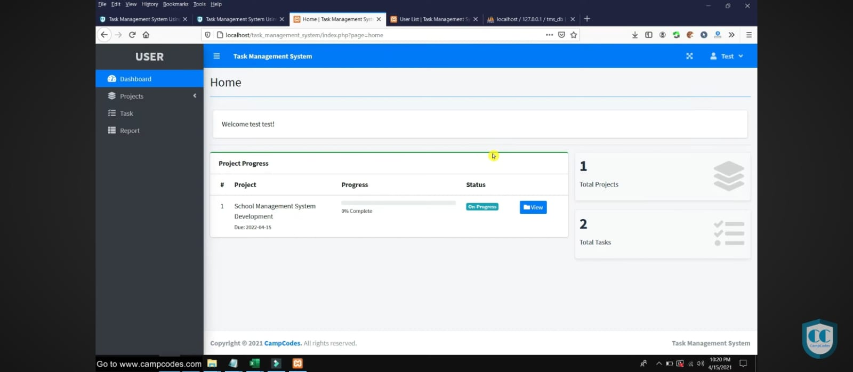
3. Task Tracking & Progress Module

Slide 13
Module Description (Cont..)
4. Notification & Reminder Module
Deadline Reminders: Automated reminders before task due dates via email, SMS, or app.
Overdue Alerts: Notify users and admins of overdue tasks with escalation options.
Custom Notification Settings: Allow users to choose how and when they receive alerts.
Real-Time Push Notifications: Immediate updates on task assignment, status change, or comments.
Centralized Notification Center: In-app panel to manage, read, or dismiss notifications

Slide 14
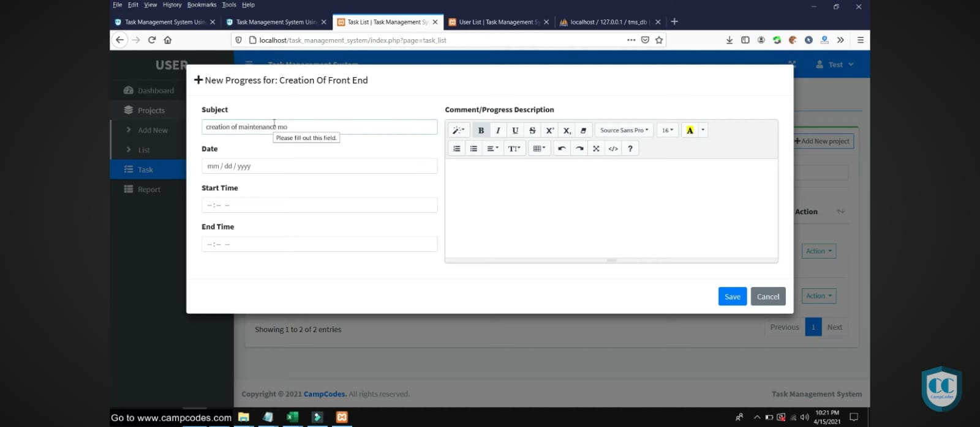
4. Notification & Reminder Module

Slide 15
Module Description (Cont..)
5. Reports & Analytics Module
Completion Reports: Track completed vs. pending tasks for individual users or teams.
Productivity Metrics: Analyze user performance based on deadlines met, tasks completed, etc.
Interactive Dashboards: Visualize data with pie charts, bar graphs, and timelines.
Export Options: Generate and download reports in PDF or Excel format for meetings or audits.
Custom Report Builder: Filter and generate reports based on date range, user, category, etc.

Slide 16
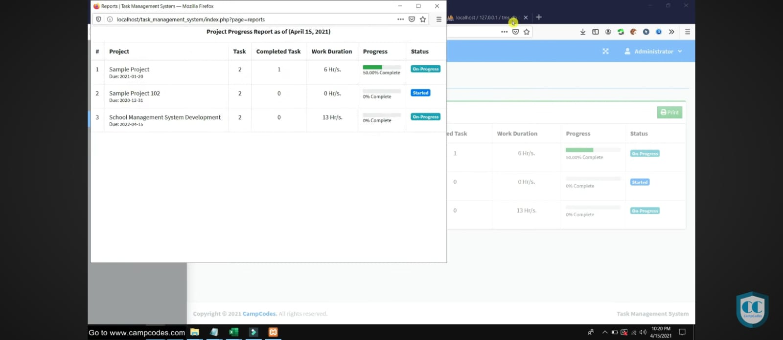
5. Reports & Analytics Module

Slide 17
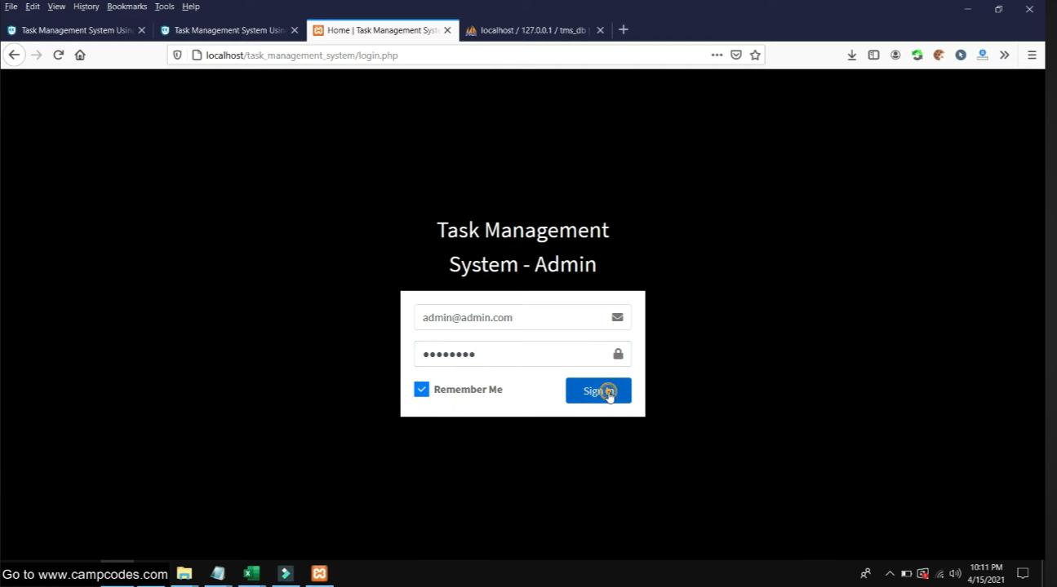
Results
CGB1221-DATABASE MANAGEMENT SYSTEM

Slide 18
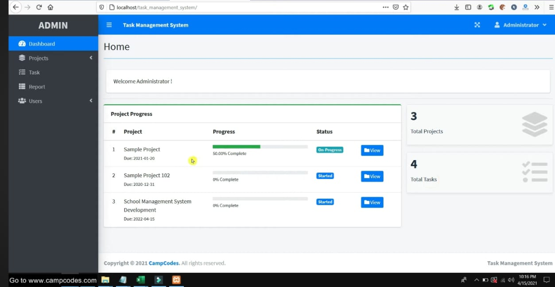
Results

Slide 19
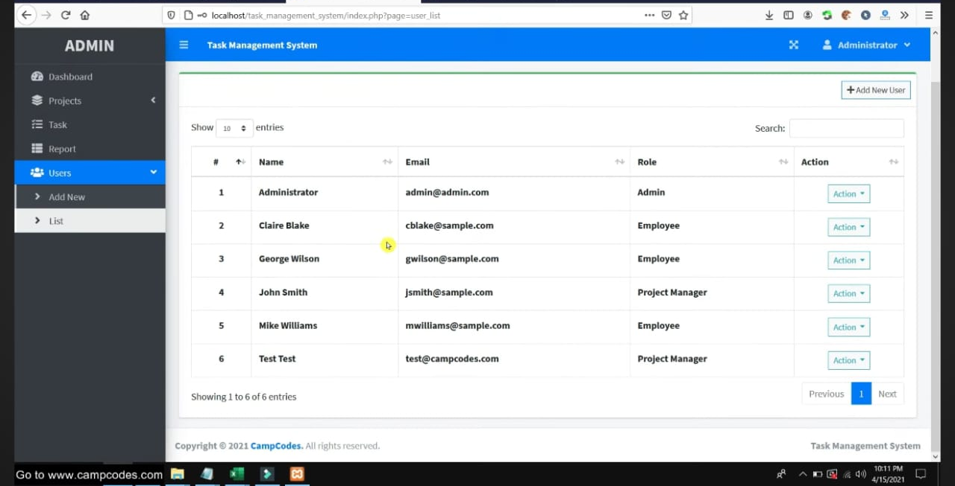
Results

Slide 20
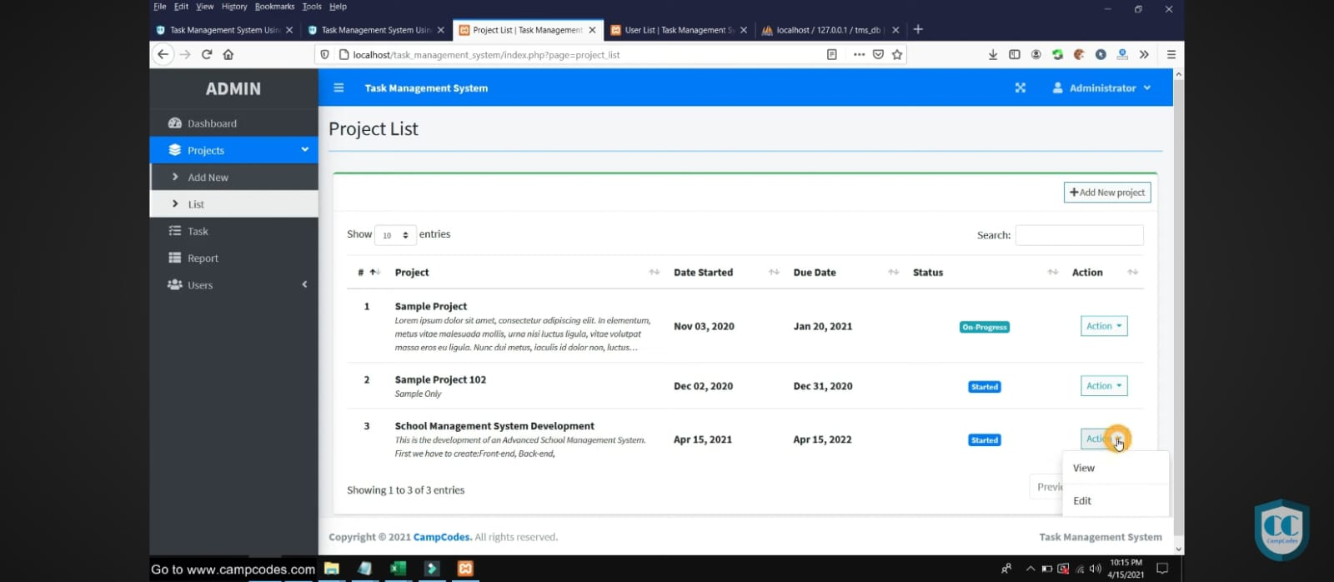
Results

Slide 21
Conclusion
Allows users to create, assign, and track tasks efficiently.
Enhances team productivity through reminders, progress tracking, and report generation.
Reduces manual effort and improves overall task management.
Supports future enhancements like mobile integration and AI-based task suggestions.

Slide 22
Thank You
Any queries???

